Slide 1

WELCOME
T2208E - SEMESTER 3 - TEAM 1

Slide 2






Table Of Contents
Introduction
Problem and Solution
Project Implementation
Achievement
Oriented development
FAQ

Slide 3

1.
Introduction

Slide 4

Vehicle Insurance Management
This project aims to develop a complete fully functional independent system with the intention of improving the productivity of the operations of company through speedy and accurate processing and efficient storage and retrieval of data.

Slide 5

2.
Problem and Solution

Slide 6
Problems
Interface
Login
The site should have menu categorising required functionalities
Home page
About us
Types of insurance
Testimonials
Contact us
1. Customer:
a. User needs to register as customer by providing the necessary information in the registration form and provide the user name and password
b. Customer can login with unique user name and password.
c. He can change the password.
d. Can purchase the policy online: For purchasing the policy online, he has to fill in the application form which would capture all the required information about the vehicle. On successful payment, copy of policy would be generated which customer can save for the records.
e. Initiate the claim by filling the claim form.
2. Employee:
a. Employee will be admin who can login with admin user name and password.
b. He can perform all the admin functions as maintaining the policy records, claim records, payment schedules etc
c. Following reports needs to be generated
i. Monthly sell of policies
ii. Vehicle wise analysis
iii. Claims report
iv. Policies due renewals
v. Policies lapsed report

Slide 7
Requirements
Module Login
Module Customer Information
Module Vehicle Information
Login module allows only authorized user to access the system.
In this module, system stores customer’s information in database.
In this module, system stores vehicle’s information in database.
Module Estimate
Module Insurance Process
Module Company Billing Policy
This module generates estimates for the Vehicle insurance enquired by customer.
This module, customer takes vehicle insurance from company. System maintains the records in database.
This module, generate the customer bill and store its payment detail with date, bill number and car information policy number.
Module Company Expenses
Module Report
Module Claim Details
In this module, generate the report of company monthly insurance and income and customer report.
In this module, store the showroom expenses. Expenses type, expenses amount, expenses date.
In this module the details of the claims initiated and approved are maintained.

Slide 8

Project Implementation
3.

Slide 9
Project Plan
Introduction
Plan
Analysis - Design
Supporting Plans
Project implementation
Technology used in the project
Results
Conclusion and Oriented Development

Slide 10
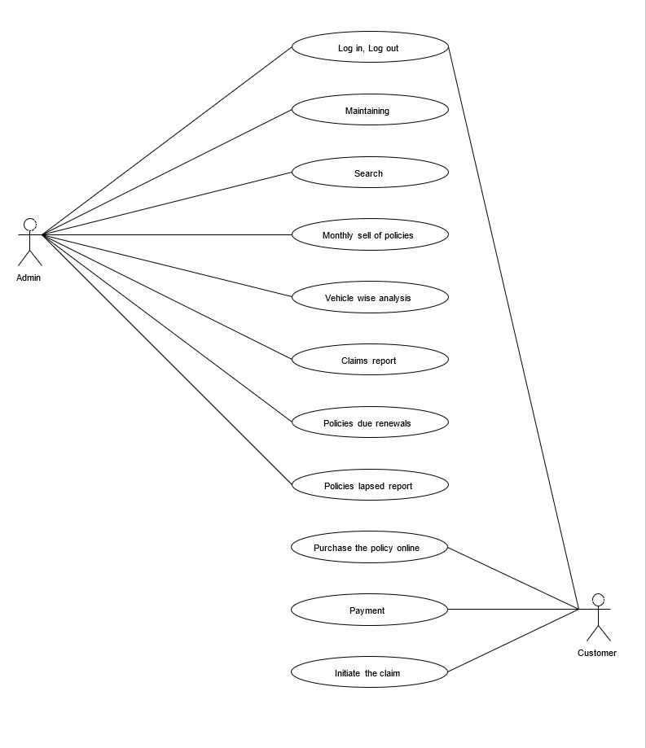
Use Case

Slide 11
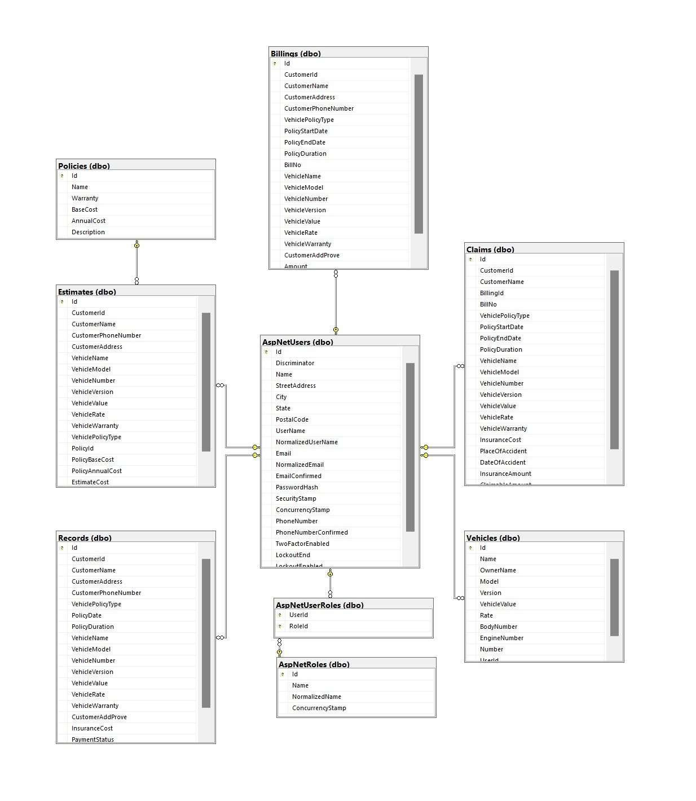
Database Diagram

Slide 12
Technology
Vehicle insurance calculation formula
Hashing
MVC ASP.NET 8.0
Database Microsoft SQL Server
Deploy to Azure

Slide 13

4.
Achievement

Slide 14

Video Demo

Slide 15
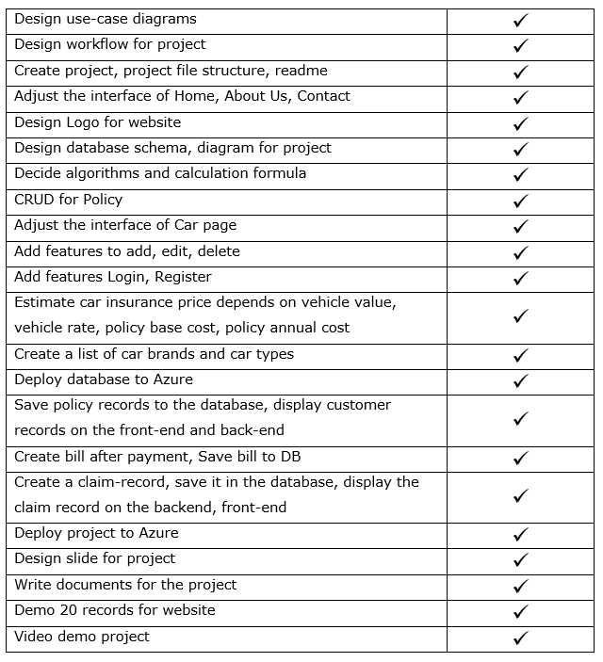
Check list

Slide 16

Oriented Development
5.

Slide 17

In the Future
From the management point of view works can be done fast and more accurately as compared to existing manual system. From the customer’s point of view he can get immediate services without any kind of wasting of time whereas from the user’s point of view all kinds of transitions can be done in very easy and efficient manner. The system also provides many kind of reports generation facility. Our main objectives for developing this project are giving below.
_{DATA SECURITY.}
_{REDUCED PAPERWORK.}
_{REDUCED MANPOWER.}
INCREASED OPERATIONAL EFFICIENCY.
INCREASED ACCURACY AND RELIABLITY.
_{IMPROVE MORAL.}
_{REDUCE OPERATIONAL TIME}

Slide 18

6.
FAQ

Slide 19
THANKS FOR YOUR WATCHING AND LISTENING.

